Slide 1

AURORA BANK
Secure Your Future, Grow your Wealth
Presented by
Ihediohamma Confidence

Slide 2
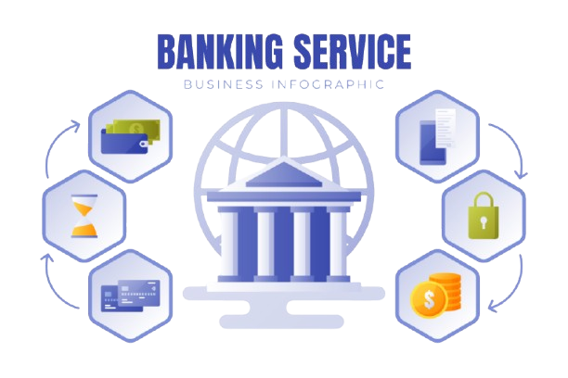
TABLE OF CONTENT
1
Introduction
2
Problem Statement
3
Key Performance Indicators
4
Data Analysis and Key Findings
5
Recommendation
6
Conclusion

Slide 3
INTRODUCTION
The Aurora Banking institution aims to gain insights into customer behavior, transaction patterns, and financial performance. This analysis will provide a comprehensive understanding of the bank's operations. By examining card transactions, customer demographics, and financial data, the bank can identify areas for improvement. The goal is to inform business decisions with data-driven insights. This analysis will help Aurora Bank optimize its operations, improve customer satisfaction, and reduce risk. The analysis will focus on transaction trends, customer behavior, and financial performance. It will provide actionable recommendations to enhance the bank's overall performance.

Slide 4
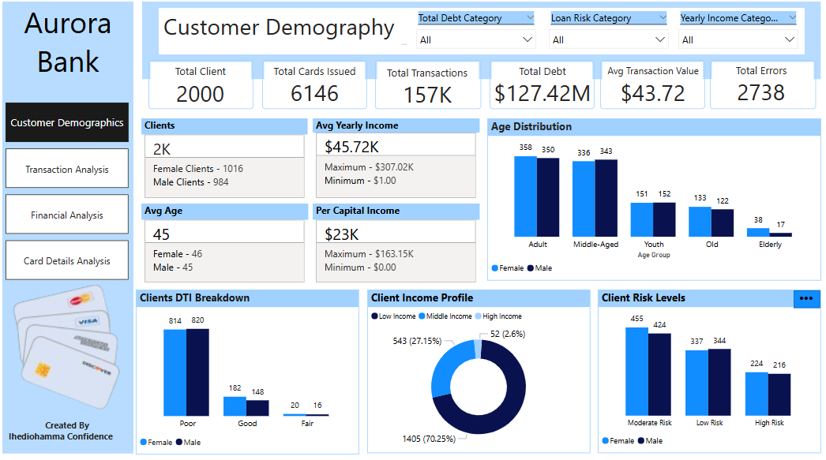

Slide 5
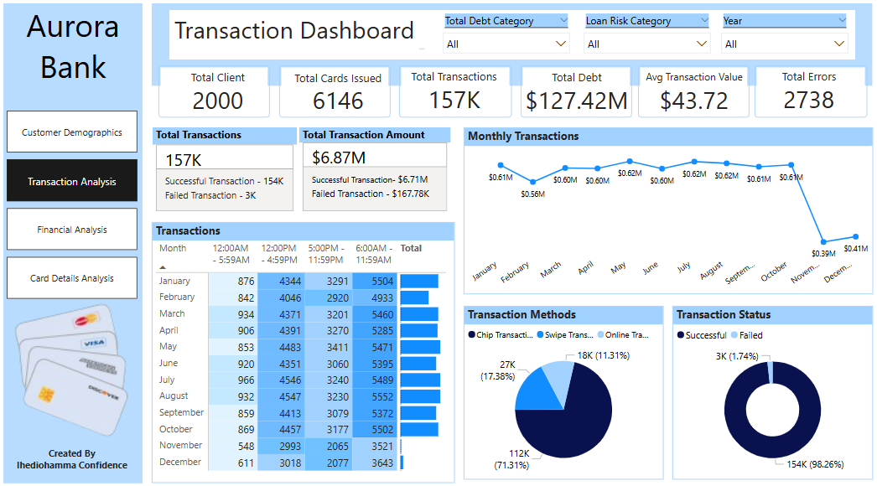

Slide 6
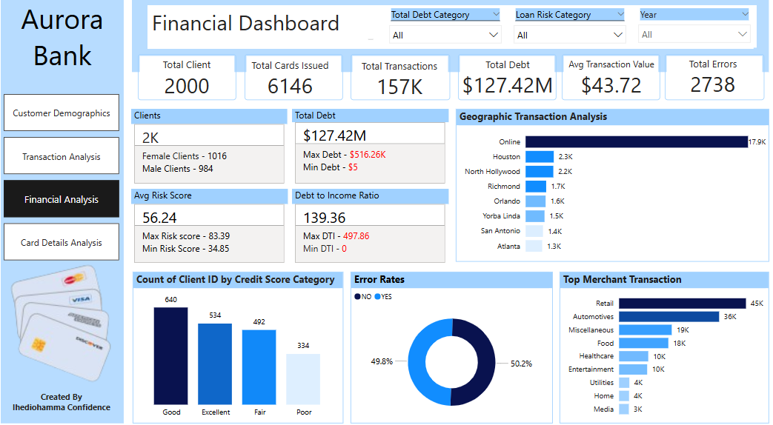

Slide 7
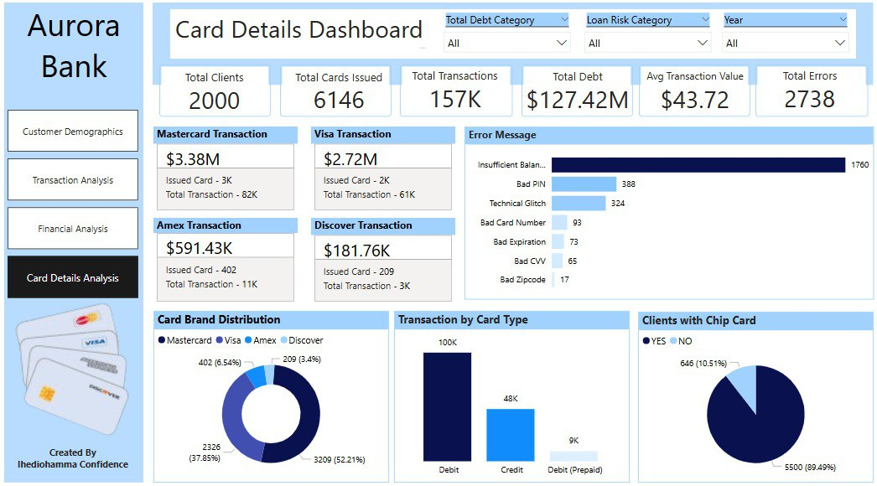

Slide 8
PROBLEM STATEMENT
Aurora Bank faces significant challenges due to limited visibility into customer behavior, transaction patterns, and financial performance. This lack of insight hinders the bank's ability to understand customer needs and preferences, identify trends, and monitor debt and risk exposure. As a result, the bank is exposed to potential losses due to ineffective risk management and makes suboptimal business decisions. Furthermore, the bank misses opportunities for growth due to its inability to capitalize on data-driven insights. This analysis will provide actionable insights to inform strategic decisions and mitigate potential risks. By leveraging these insights, the bank can drive business growth, improve customer satisfaction, and reduce risk. Ultimately, this will enable the bank to improve its competitiveness and drive sustainable growth.

Slide 9


KEY PERFORMANCE INDICATORS
Total Clients
This is the total number of active customers
Total Cards Issued
This is the total number of cards issued to customers
Transaction Volume
The number of transactions processed
Total Debt Exposure
This is the total amount of debt outstanding
Error Rate
Number and percentage of transactions that encounter errors

Slide 10

OBJECTIVES
To assess the performance and usage of different card types and brands to inform future product development and service enhancements.
To Analyze financial profiles and credit card usage patterns to predict the likelihood of default, enabling more accurate credit limit assignments and loan approvals.
Track and evaluate customer spending habits across different merchant categories, locations, and transaction types to gain insights into consumer preferences and lifestyle trends.
Explore regional trends in spending and financial behavior by analyzing transaction data in relation to geographic indicators such as city, and state
Identify unusual or suspicious transaction behaviors using chip usage patterns, error logs, and location data to enhance fraud prevention mechanisms.

Slide 11
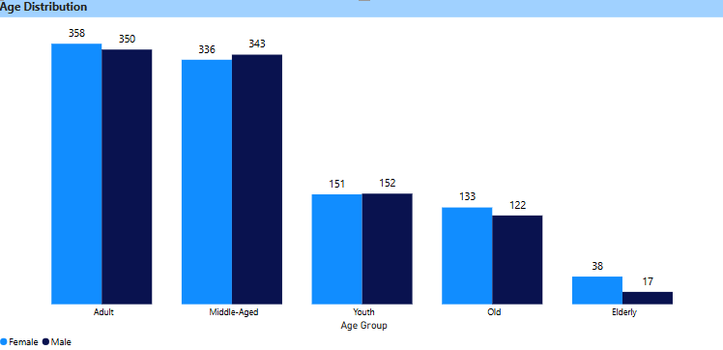
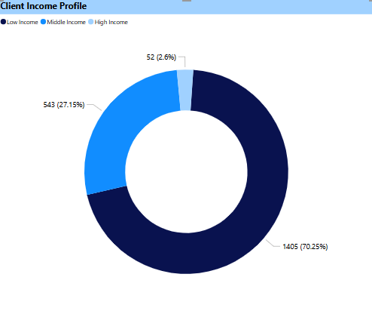
KEY FINDINGS AND INSIGHT
The age distribution shows a clear picture of the bank’s core demographic. The adult (ages 26–45) and middle-aged (ages 46–60) groups form the largest segments, with nearly equal gender representation in each (358 females vs. 350 males in adults, and 336 females vs. 343 males in middle-aged clients). This indicates that the bank's current client base is largely composed of economically active individuals, which aligns with the typical profile of financially engaged customers. The youth segment (ages 18–25) is also relatively balanced, suggesting that the bank is making some headway in attracting younger users. However, the numbers drop significantly in the older age brackets, particularly among the elderly, where there are only 38 female and 17 male clients. This gap could reflect barriers in accessibility or a lack of tailored services for older customers.
The Client Income Profile chart reveals that the majority of clients fall into the high-income category, accounting for 70.25% of the total client base. This indicates a strong skew toward wealthier individuals. In comparison, middle-income clients make up 27.15%, while only 2.6% of clients are categorized as low-income.

Slide 12
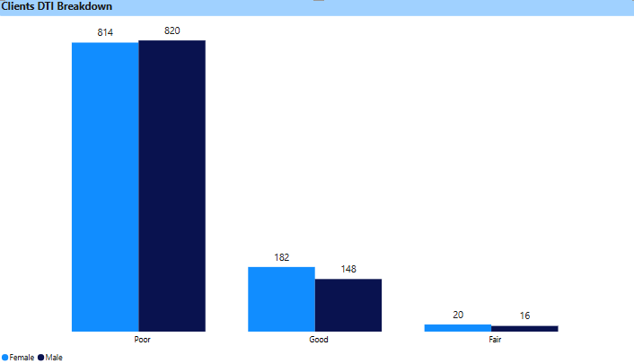
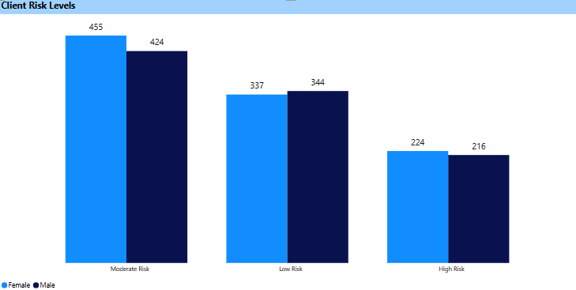
The Debt-to-Income (DTI) ratio breakdown by gender, shows a significant proportion of both male and female clients fall under the “poor” DTI category, with 820 males and 814 females. This suggests that most clients are burdened with debt levels that are disproportionately high relative to their income. Interestingly, a slightly higher number of females (182) fall into the “good” category compared to males (148), indicating that female clients may, on average, manage their debt slightly more effectively. The “fair” category is sparsely populated, with only 20 females and 16 males, underscoring the need for stronger financial literacy and debt management strategies among the bank’s clientele.
The distribution of client risk levels reveals that the majority of clients fall under the moderate risk category, with 455 females and 424 males. This suggests that most clients, regardless of gender, exhibit characteristics that place them in a mid-level risk bracket. Interestingly, while the numbers are close, females slightly outnumber males in both the moderate and high-risk categories, indicating a marginally higher representation of females in riskier segments. On the other hand, in the low-risk category, males (344) slightly outpace females (337), pointing to a minor tilt towards lower risk among male clients. Overall, the gender distribution across risk levels remains relatively balanced.

Slide 13
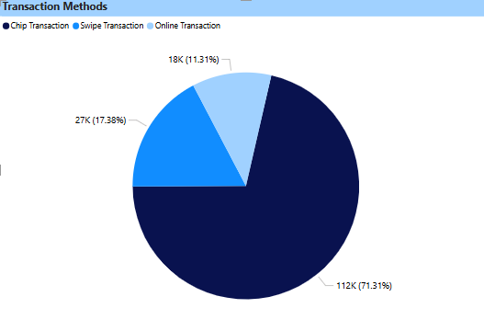
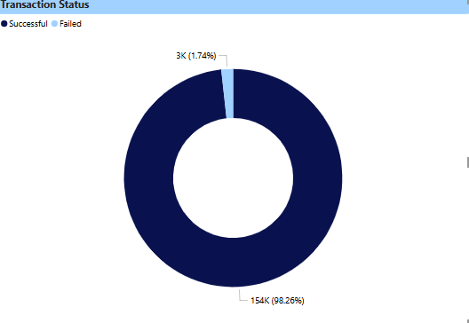
From the chart, 112K transactions (71.31%) were done using Chip Transaction methods, this indicates that chip-based payments are the most preferred and widely used method, possibly due to better security or ease of use. 27K transactions (17.38%) were done through Swipe Transactions, though still in use, this method is significantly less popular compared to chip transactions, possibly due to being less secure or older technology. While 18K transactions (11.31%) were conducted through Online Transactions, this might suggest a lower adoption of digital platforms or user trust concerns.
The data reflects a highly efficient transaction system, with 154K successful transactions accounting for an impressive 98.26% of all activity. Only 3K transactions (1.74%) failed, indicating that system reliability and transaction processing are functioning at a very high level. This low failure rate could be attributed to effective error handling, or consistent user behavior. Maintaining such a high success rate is crucial for user trust and operational efficiency.

Slide 14
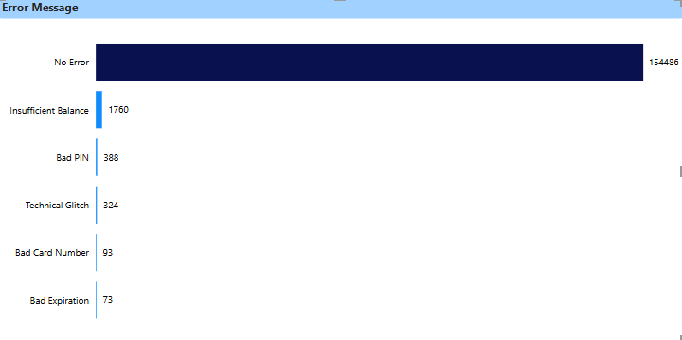
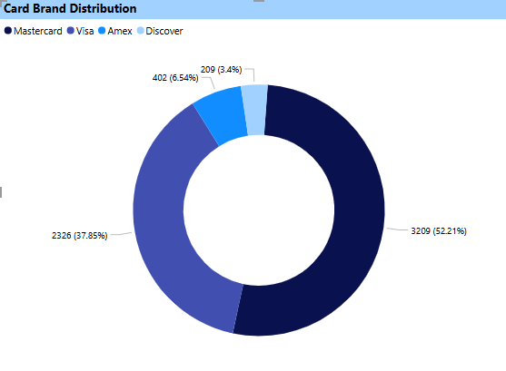
The error message analysis reveals that the vast majority of transactions were processed successfully, with a remarkable 154,486 instances showing no error. This indicates a high level of system reliability and operational efficiency across the bank’s transaction channels. However, the most prevalent issue is transactions failing due to “Insufficient Balance”, which occurred 1,760 times. This suggests that a significant number of clients are either unaware of their account balances or are consistently attempting transactions without adequate funds. Additionally, there were 388 instances of “Bad PIN” entries, and 324 Technical Glitches, which may indicate either user experience problems or underlying system instability. Less frequent errors include bad card numbers (93 cases) and bad expiration dates (73 cases), which are likely due to outdated card details or manual entry mistakes
In the Card Brand Distribution chart, Mastercard emerges as the most widely used card brand among clients, with 52.21% of users holding a Mastercard. Visa follows as the second most popular, representing 37.85% of the client base. On the other hand, Amex and Discover trail significantly behind, with only 6.54% and 3.4% of users, respectively.

Slide 15


RECOMMENDATION
Adjust credit limits based on customer credit score, income, and transaction history to minimize risk.
Develop inclusive financial products such as no-fee savings accounts, small-scale credit lines, or micro-loans with flexible repayment terms.
Developing more inclusive and user-friendly digital platforms could help bridge the gap between the youth and elderly age group, while products targeting youth, such as beginner investment accounts or educational savings plans. Could further strengthen long-term client relationships.
Launch targeted seasonal campaigns offering points multipliers or cashbacks for Merchant like travel and entertainment spends.
Interventions such as educational programs, debt restructuring options, and personalized financial planning could help shift clients toward better financial standing.

Slide 16

CONCLUSION
In conclusion, from analyzing the dataset, it's clear that customer
behavior and transaction patterns are closely tied to credit risk and demographic factors. The data reveals opportunities for targeted marketing and personalized product offerings, particularly for customers with high credit scores and low debt. Conversely, high-risk customers with poor credit history and high debt levels require proactive risk management strategies. The dataset also highlights the importance of merchant partnerships and robust fraud detection measures. By leveraging these insights, organizations can optimize their operations, improve customer satisfaction, and drive business growth. Overall, the dataset provides a rich source of information for data-driven decision-making and strategic business planning. The findings can inform a range of business initiatives, from product development to risk management.

Slide 17


